Slide 1

Neural-based Speech Generation
[2021]
Yi-Chiao Wu
Toda Lab, Nagoya University, Japan
Notes:
[opening]
Hello everyone, I’m Wu Yi-Chiao. Today, I would like to give my final talk.

Slide 2

About me https://bigpon.github.io/
Education
[2017–2021] Nagoya University, informatics (Ph.D.)
Speech synthesis, voice conversion
[2005–2012] National Chiao Tung University, communication engineering (MS, BS)
Speaker verification
Work experience
[2015–2017] Academia Sinica, research assistant
Voice conversion, speech enhancement
[2013–2015] ASUS, software R&D
Speaker verification
[2012–2013] Realtek, TV system designer
Notes:
[about me]
Before starting my presentation, I would like to introduce myself first. I receieved my Ph.D. degree at Nagoya University in this March. Before I started my P.hD program, I worked for Academia Sinica, which is the largest academic research institute in Taiwan, for 2 years. Before working in Academia Sinica, I worked in the IT industry in Taiwan for three years.

Slide 3
Research Overview
Today’s topic
Notes:
[research overview]
During my master's program and working in ASUS, my research focused on speaker identification. I adopted the conventional GMM-based method, and I also developed a real-time system with a Windows user interface and an Android App. Moreover, my system was integrated with a microphone array and face recognition.
In Academia Sinica, I developed an exemplar-based voice conversion system to achieve above-average performance in Voice conversion challenge VCC 2016. I also participated in the development of VAE WGAN-based voice conversion. Furthermore, I proposed exemplar-based post-filters for the speech denoising autoencoder.
At Nagoya University, I continue the voice conversion research and participated in VCC 2018 and 2020. I also corporate with my colleague to provide a CycleVAE baseline system for VCC 2020. Furthermore, I proposed some robustness and flexibility improvements for CNN-based neural vocoders such as WaveNet and Parallel WaveGAN. I also proposed a neural-post-filter for low-cost TTS systems. Today, my talk focuses on the neural vocoder work.

Slide 4
Outline
Background
Neural vocoder
Quasi-periodic neural vocoder
Experiments
Discussion
Conclusion
Notes:
[outline]
This is my outline. First, I would like to introduce basic speech background such as fundamental challenges in speech generation to let you easier get into my research. I will also briefly introduce the developments of recent speech generative models such as CNN-based and RNN-based models. Then, I will introduce our proposed QP structure with pitch-dependent dilated convolution neural networks and show how we apply these modules to WaveNet and Parallel WaveGAN models. In the end, I will give some discussions and conclusions about my proposed method and recent speech generation techniques.

Slide 5
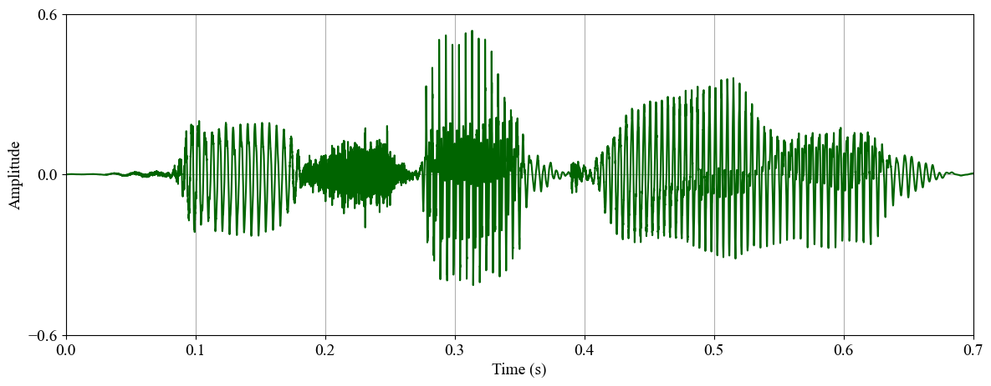
Speech Signal
Sequential signal
Very high temporal resolution (F_{s} >= 16kHz)
Very long-term dependency
Directly modeling speech waveform is challenging
Notes:
[speech characteristic]
As we know, speech is a sequential signal with a very high temporal resolution. The sampling rate of a speech signal is usually higher than 16 kHz, so it means that we need to model more than 16 thousand sample points in one second. Since speech samples have a very long-term dependency. Directly modeling speech waveform is challenging.

Slide 6
Vocoder [H. Dudley, 1939]
Vocoder: voice coder
Analyzer
Analyzing speech into acoustic features
Synthesizer
Synthesizing speech from acoustic features
Notes:
[vocoder]
The basic technique to tackle speech generation is “Vocoder”, which means a voice coder. It includes an Analyzer to analyze speech into acoustic features such as spectral and prosodic features, and then its Synthesizer synthesizes speech waveform based on these acoustic features.

Slide 7
Human Vocal System
Three categories of speech sounds
Voiced
Unvoiced
Plosive
Three stages of speech production
Notes:
[human vocal system]
To design a vocoder, some basic knowledge of human speech production is required. The speech sounds can be divided into voiced, unvoiced, and plosive three categories, and the characteristic of plosive sound is similar to that of unvoiced sound. There are three main stages of speech production. First, excitation generation. A source airflow goes through the vocal fold vibration to generate voiced excitation or constriction of specific points to generate unvoiced and plosive excitations. Secondly, the excitation signal is modulated by the vocal tract and nasal tract resonance. Last, the speech is transmitted by the lips radiation.

Slide 8
Source-filter Model [R. McAulay+, 1986]
Speech generation is formulated as a convolution of a digital signal and a digital filter in a digital signal processing system
Digital excitation (source) signal
Modeling the glottal waveform
Digital spectral filter
Modeling the vocal and nasal tracts resonances and lip radiation
Notes:
[source-filter]
As a result, digital speech generation is formulated as a convolution of a digital signal and a digital filter. The digital excitation signals include voice and unvoiced excitations modeling the glottal waveforms with and without vocal fold movements. The voiced excitation is a quasi-periodic signal with clear harmonic components. The unvoiced excitation is a white noise-like signal. The vocal tract resonance is modeled by a digital time-variant spectral filter. Furthermore, we usually use a high-pass filter to model the lip radiation.

Slide 9
Source-filter Vocoder
Speech spectral envelope modeling
Linear prediction coding (LPC) [B. S. Atal+, 1971; D. Wong+, 1982]
Mel-generalized cepstrum (MGC) [S. Imai, 1983; T. Fukada+, 1992]
Simplest excitation modeling
Unnatural harmonic components → Buzzy noise
Missed harmonic components → Hissy noise
Notes:
[source-filter]
For a source-filter vocoder, the speech spectral envelope can be estimated by LPC or MGC, and the excitation can be simply modeled by white noise and pulse train generated according to the fundamental frequency. However, the too simplified excitation modeling will degrade the naturalness of the generated speech. The unnatural harmonic components will cause buzzy noise and the missed harmonic components will cause hissy noise.

Slide 10
Mixed Excitation Vocoder
Multi-band mixed excitation vocoder
STRAIGHT [H. Kawahara+, 1999], WORLD [M. Morise+, 2016]
Modeling excitation using Gaussian noise, subband aperiodicity (ap), and fundamental frequency (F₀)
Lost temporal details and phase information cause speech quality degradation
Notes:
[mixed excitation vocoder]
Therefore, there are many advanced techniques to better model excitation singals.
One of the most popular source-filter vocoders is the mixed excitation vocoder such as STRAIGHT and WORLD. As shown in this figure, in the analysis stage, the mixed excitation vocoder first extracts the fundamental frequency (F0) of the input speech, and then it extracts aperiodicity (ap) and spectral envelope (sp) based on the extracted F0. In the synthesis stage, the vocoder first generates the mixed excitation signal based on the F0, ap, and white noise. Then, the mixed excitation signal is filtered by the spectral filter to generate synthetic speech. However, phase information and some temporal details are discarded during the analysis-synthesis process, which causes significant speech quality degradation.

Slide 11
RNN-based Speech Generation
Speech is a sequential signal ➔ RNN
Speech has a very high temporal resolution
Gradient vanishing/explosion for RNN modeling a signal with a very long term dependency
Generation time is extremely long
Notes:
[RNN-based SS]
Recently, instead of using conventional vocoders, many neural-based speech generative models have been proposed. When thinking about modeling a sequential signal like speech, the straightforward method is using a recurrent neural network (RNN). However, since speech has a very high temporal resolution, the RNN model will suffer from gradient vanishing or explosion problem when modeling such long term dependencies. Moreover, the sample by sample generation of the RNN model easily results in a very time-consuming generation.

Slide 12
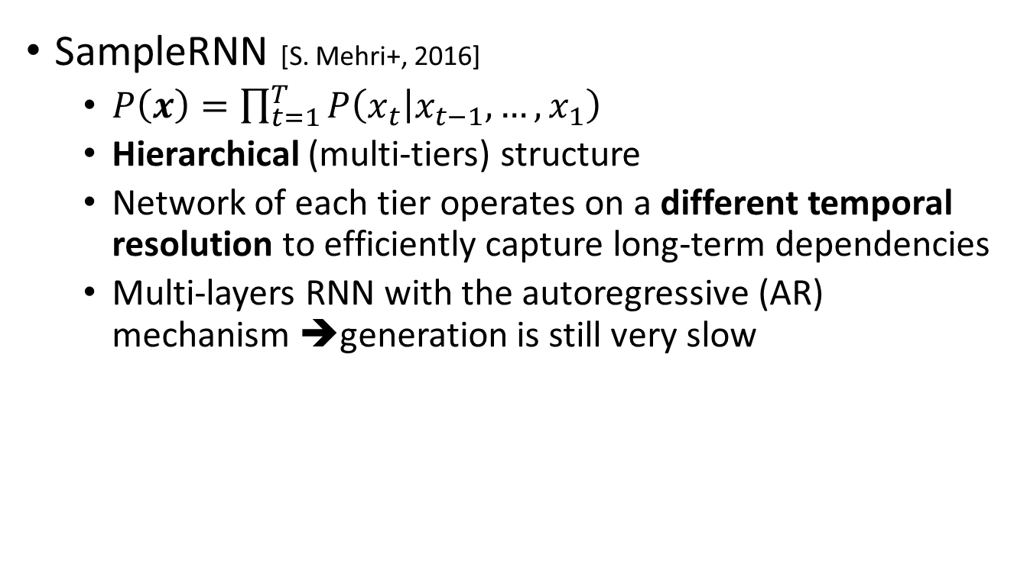
RNN-based Speech Generation
SampleRNN [S. Mehri+, 2016]
$P\left(x\right)=\prod_{t=1}^{T}{P\left(\left.x_{t}\right|x_{t−1},…,x_{1}\right)}$
Hierarchical (multi-tiers) structure
Network of each tier operates on a different temporal resolution to efficiently capture long-term dependencies
Multi-layers RNN with the autoregressive (AR) mechanism ➔generation is still very slow
Notes:
[SampleRNN]
To tackle the weakness of RNN for modeling a long sequence, SampleRNN has been proposed in 2016. The dependency among speech samples has been formulated as a conditional probability. The probability distribution of each sample is conditioned on all previous samples. SampleRNN adopts a hierarchical structure with multiple RNN layers, and each layer operates on a different temporal resolution. Therefore, the network can model the long-term dependency well with the captured hierarchical information of the speech signal. However, the multi-layer RNN and the autoregressive mechanism still make the generation very slow.

Slide 13
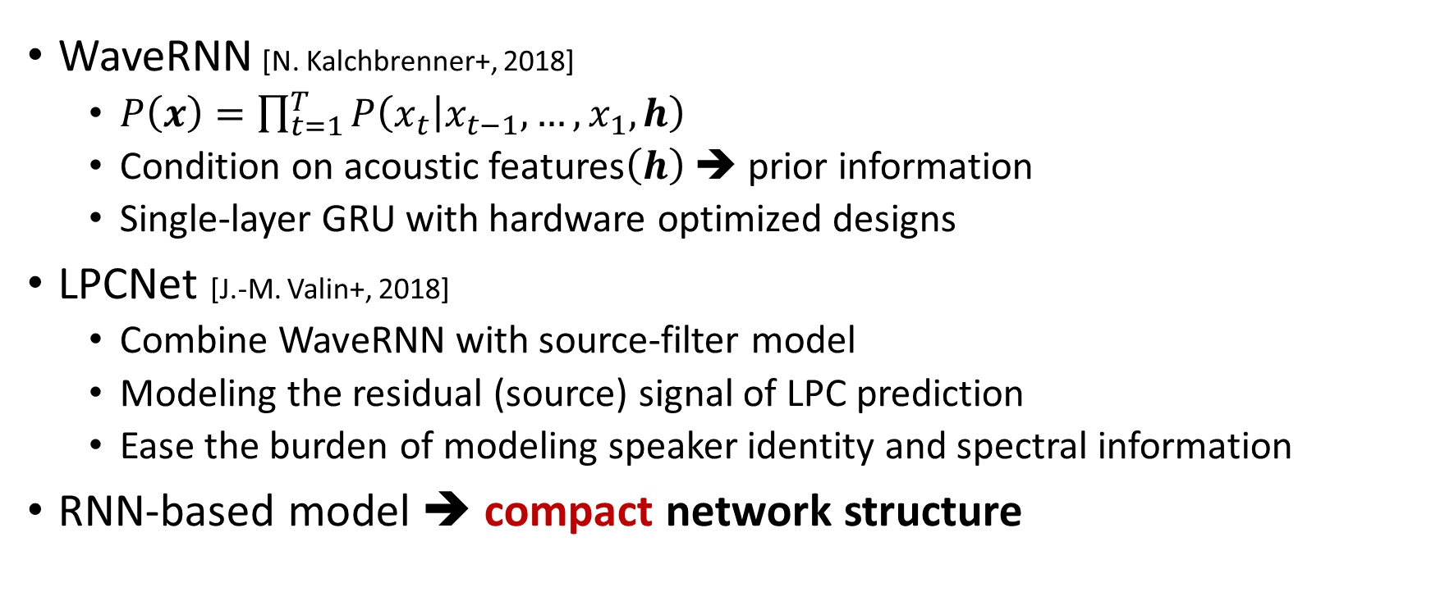
Real-time RNN-based Vocoder
WaveRNN [N. Kalchbrenner+, 2018]
$P\left(x\right)=\prod_{t=1}^{T}{P\left(\left.x_{t}\right|x_{t−1},…,x_{1},h\right)}$
Condition on acoustic features$\left(h\right)$ ➔ prior information
Single-layer GRU with hardware optimized designs
LPCNet [J.-M. Valin+, 2018]
Combine WaveRNN with source-filter model
Modeling the residual (source) signal of LPC prediction
Ease the burden of modeling speaker identity and spectral information
RNN-based model ➔ compact network structure
Notes:
[WaveRNN, LPCNet]
To achieve real-time speech generation, WaveRNN and LPCNet have been proposed in 2018. WaveRNN makes network not only conditioned on previous speech samples but also acoustic features. Since the acoustic features are very strong prior information, a single-layer GRU with some specific hardware optimized designs achieves real-time generation. Furthermore, the authors of LPCNet combine WaveRNN with the source-filter model. That is, the network only focuses on generating the residual signal of LPC prediction. Since the residual signal is speaker-independent, the burden of modeling speaker identity and spectral information has been eased. Therefore, a very compact network is enough for LPCNet. In conclusion, the main challenge of the recent RNN-based speech generation models is how to develop a very compact model for real-time speech generation.

Slide 14
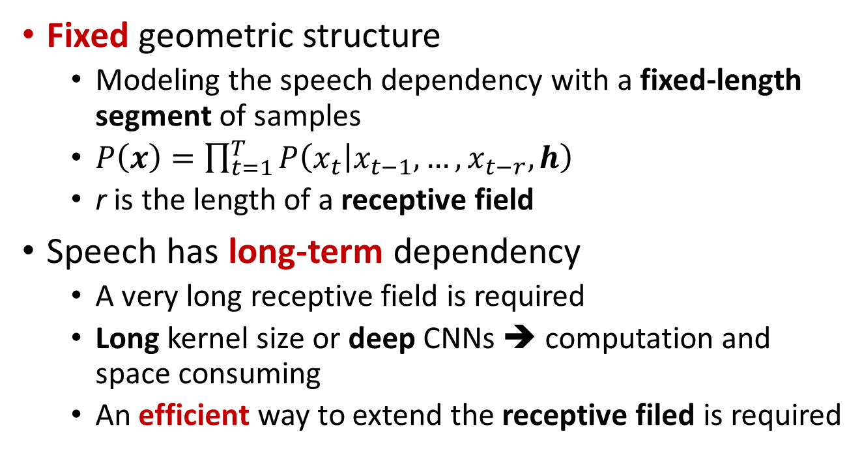
CNN-based Speech Generation
Fixed geometric structure
Modeling the speech dependency with a fixed-length segment of samples
$P\left(x\right)=\prod_{t=1}^{T}{P\left(\left.x_{t}\right|x_{t−1},…,x_{t−r},h\right)}$
r is the length of a receptive field
Speech has long-term dependency
A very long receptive field is required
Long kernel size or deep CNNs ➔ computation and space consuming
An efficient way to extend the receptive filed is required
Notes:
[CNN-based SS]
On the other hand, many CNN-based speech generative models also have been proposed. Since CNN has a fixed geometric structure without any recurrent mechanism, the number of conditional previous speech samples is fixed. The fixed-length segment is a receptive field. To model the very long-term dependency of speech, a very long receptive field is required. A long receptive field can be achieved by large kernel size or deep CNNs. However, computation and space requirements are also markedly increased. Therefore, one of the main challenge of the CNN-based models is an efficient way to extend the receptive field.

Slide 15
WaveNet w/ DCNN
Dilated CNN (DCNN) [F. Yu+, 2016]
Convolution with gaps (dilation size)
WaveNet (WN) [A. Oord+, 2016]
Stacked DCNNs to get long receptive fields
Huge network w/ the AR mechanism ➔ slow generation
Notes:
[WaveNet]
The first CNN-based model achieving a state of the art performance is WaveNet. WaveNet adopts dilated convolution neural networks (DCNN) to efficiently enlarge the receptive field. Take a CNN with a size 2 kernel as example, the dilation size of the first layer is one, and it means that the kernel samples the current input and the first past input. If the dilation is two, the kernel still samples the current input but skip the first past input to sample the second past input. When the dilation size is four, the kernel will sample the current and the fourth past inputs. Stacked DCNNs with different dilation sizes efficiently increase the receptive field length and capture the hierarchical information of the speech signal. However, it still needs 30 DCNN layers to achieve good speech quality. The huge network and the AR mechanism of WaveNet make its generation very slow. It usually takes more than one minute to generate one-second speech.

Slide 16
Non-AR CNN-based Model
Flow-based
IAF: parallel WN [A. Oord+, 2017], Clarinet [W. Ping+, 2019]
Glow: WaveGlow [R. Prenger+, 2019], Flowavenet [S. Kim+, 2019]
CNF: WaveFFJORD [N.-Q. Wu+, 2020], WaveNODE [H. Kim+, 2020]
Invertible network to transfer a distribution of white noise to the distribution of speech
Training is difficult and model is huge because of the invertible requirement
Notes:
[Flow-based SS]
As a result, many non-AR CNN-based models have been proposed to utilize the parallel generation advantage of the non-AR mechanism to achieve real-time generation. For example, parallel WaveNet and Clarinet adopt an inverse autoregressive flow to avoid the AR manner in the generative stage. However, the IAF approach needs a well-trained AR model as a teacher model. Therefore, the authors of WaveGlow and Flowavenet adopt Glow to make the models be directly trained with maximum likelihood of Gaussian distribution without the requirement of a teacher model. However, the Glow has some limitation of its Jacobian form and results in a huge network requirement. Therefore, WaveFFJORD and WaveNode have been proposed to adopt continuous normalize flow with a freeform Jacobian.
The main concept of these flow-based models is adopting an invertible network conditioned on acoustic features to transfer speech to Gaussian noise in the training stage and recovery the speech signal from the Gaussian noise and the acoustic features in the testing stage.
However, the invertible requirement usually results in difficult training and a huge network.

Slide 17
Non-AR CNN-based Model
GAN-based
Stability of GAN training is a issue
Using multi-STFT losses: parallel WaveGAN (PWG) [R. Yamamoto+, 2020]
Using multi-discriminators: MelGAN [K. Kumar+, 2019]
Notes:
[GAN-based SS]
Furthermore, GAN-based non-AR models such as parallel WaveGAN (PWG) and MelGAN have also been proposed, and they adopt GAN to attain very compact generative models with high fidelity speech generation. However, as we know, the stability of GAN-training is challenging. PWG adopts a multi-short-time-Fourier-transform (multi-STFT) loss module to keep GAN-training stable. The generator of PWG is a non-AR WaveNet, and its inputs are white noise and upsampled acoustic features, which have matched temporal length as the target speech waveform. The generator is trained with both the GAN loss and the multi-STFT losses with different FFT lengths, frame lengths, and hop sizes. The multi-STFT losses make the generator capture hierarchical information of speech signals and make the training stable. Instead of multi-STFT losses, MelGAN adopts multiple discriminators operated on different temporal resolutions to make its generator capture hierarchical information. In conclusion, capturing hierarchical information of speech signals is a key point for making GAN-training stable.

Slide 18
Non-AR CNN-based Model
Source-filter-based
Neural source generation: GlotGAN [L. Juvela+, 2019], GELP [L. Juvela+, 2019]
Neural filtering: NSF [X. Wang+, 2019]
Differentiable DSP: DDSP [J. Engel+, 2019], NHV [Z. Liu+, 2020], HooliGAN [O. McCarthy+, 2020]
Notes:
[Source-filter-based SS]
Many CNN-based source-filter vocoders also have been proposed. Let me review the conventional mixed excitation source-filter vocoder first. A pulse train is generated based on the F0 and processed by a band pass filter and a phase control module to generate voiced excitations. White noise is processed by another band pass filter to generate unvoiced excitations. The mixed excitation is processed by a spectral filter to generate the synthetic speech. For neural-based source-filter vocoder, GlotGAN and GELP adopt a CNN-based model with a GAN structure to generate excitations and then processed by a parametric-based spectral filter. NSF adopts a neural spectral filter to processed their handcrafted excitations. Furthermore, DDSP, NHV, and HooliGAN adopt totally differentiable source-filter models to generate speech.

Slide 19
Source-filter Vocoder
Vocoder with a source-filter structure
Notes:
[Vocoder summarize 1]
To summarize, the vocoder techniques include two main categories, source-filter vocoder, and unified vocoder. A source-filter vocoder includes an excitation generation module and a resonance filtering module. The inputs are acoustic features and the output is speech waveform. For conventional vocoders, both modules are parametric-based like AR-based LPC vocoder and MGC vocoder or non-AR-based STRAIGHT and WORLD. Because of the powerful modeling capability of neural networks, we can replace the excitation module with a neural network such as AR-based LPCNet and non-AR-based GlotGAN and GELP, or we can replace the filtering module with a neural network such as NSF. We can also replace both modules with neural networks such as DDSP, NHV, and HooliGAN.

Slide 20
Unified Vocoder
Vocoder modeling source and resonance signals w/ a single model
Notes:
[Vocoder summarize 2]
On the other hand, a unified vocoder directly models speech waveform with a single neural network. The inputs can be acoustic or linguistic features and the output is also speech waveform. Although the unified vocoders such as AR-based WaveNet and WaveRNN and Non-AR-based Parallel WaveNet and Clarinet achieve high fidelity speech generation, the pure data-driven nature with very limited prior knowledge makes them lack speech controllability, which is an essential feature of a vocoder. Therefore, we proposed a QP structure to dynamically adapt the network structure according to the instantaneous pitch. Now, we already reviewed the recent developments of speech generation, and I will start to introduce my proposed QPNet and QPPWG.

Slide 21
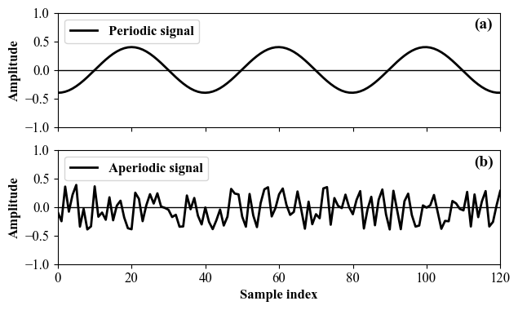
Quasi-periodic Signal
Speech signal is a quasi-periodic signal
Mixed periodic and aperiodic components
Periodic component: long-term correlation
Aperiodic component: short-term correlation
Notes:
[quasi-periodic]
As we know, speech is a quasi-periodic signal, which includes periodic and aperiodic components. The periodic component has a long-term correlation, and the aperiodic component has a short-term correlation.

Slide 22
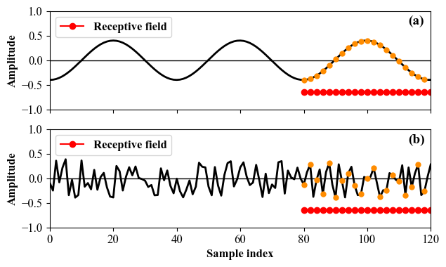
Problem of Unified Vocoder I: Inefficient speech modeling
Without the prior knowledge of audio periodicity
Fixed network for both periodic and non-periodic parts
Oversampling of periodic component
Receptive field includes many redundant samples
Notes:
[Inefficient speech]
As a result, modeling speech using a fixed unified network without any prior knowledge of audio periodicity is inefficient. For example, as shown in this figure, the fixed receptive field length and sampling sparsity make the network oversample the periodic signal, which means the receptive field includes many redundant samples.

Slide 23

Problem of Unified Vocoder II: Limited pitch controllability
Vocoder conditioned on unseen acoustic features
F₀ is not in the observed F₀ range of training data
Unseen feature pair of spectrum and F₀
Original spectral feature with scaled F₀
Difficult to generate speech
Inaccurate pitch of the generated speech
 | Normal | 2×F₀
Expected
PWG
QPPWG
Notes:
[limited pitch controllability]
Furthermore, because of the unified model nature without prior knowledge of pitch, the unified vocoders do not explicitly model periodic components. Therefore, it is difficult for these vocoders to generate speech with an accurate pitch when conditioned on acoustic features with F0 is not in the observed F0 range of training data or unseen spectral and F0 pairs.
Here are some examples.
First, I play the sounds with normal F0.
Second, I play the sounds with doubled F0.

Slide 24
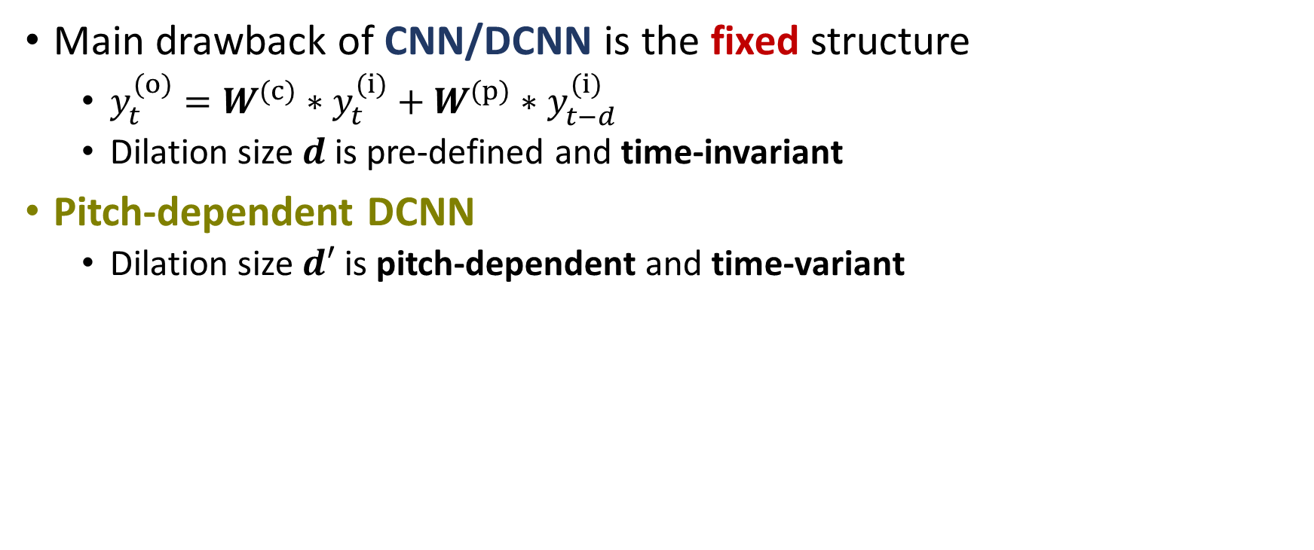
PDCNN
Main drawback of CNN/DCNN is the fixed structure
$y_{t}^{(o)}=W^{(c)}∗y_{t}^{(i)}+W^{(p)}∗y_{t−d}^{(i)}$
Dilation size $d$ is pre-defined and time-invariant
Pitch-dependent DCNN
Dilation size $d′$ is pitch-dependent and time-variant
Notes:
[PDCNN]
Now, I would like to introduce the proposed modules of QPNet and QPPWG.
The first one is PDCNN.
We know that the main drawback of CNN/DCNN is the fixed geometric structure. Specifically, convolution with a size two kernel can be formulated like this formula. “y” are feature maps, “I” denotes input, and “o” denotes output. “W^(c)” and “W^(p)” are trainable weight matrices for current and past samples, respectively. “t” is the time index, and “d” is the dilation size. For CNN, “d” is set to one. For DCNN, “d” is pre-defined and time-invariant. However, for our proposed PDCNN, the dilation size “d’” is pitch-dependent and time-variant. That is, the original dilation size “d” is multiplied by a time-variant pitch-dependent scale “E” to get the dilation size “d’” of PDCNN.

Slide 25
PDCNN Implementation
2×1 CNN = 1×1 CNN^{(c)} + 1×1 CNN^{(p)}
Getting the dilation size of each input
Indexing feature map according to the dilation size
Summation of convolution results
Indexing
Notes:
[PDCNN implementation]
For the implementation of PDCNN, since directly modifying the CNN module to dynamically change the dilation size is difficult, we dynamically index the input feature map which is equivalent to changing the dilation size. Specifically, the results of a 2×1 CNN are equivalent to the summation of the results of two 1×1 CNNs namely CNN(c) for the current samples and CNN(p) for the past samples. Therefore, we first get the dilation size of each sample, and then we index the input feature map of the 1×1 CNN(p) according to the dilation size. Finally, we sum the results of CNN^(c) and CNN^(p) to get the PDCNN results.

Slide 26
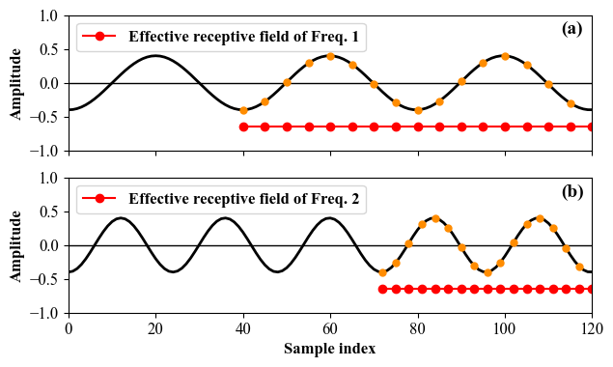
Pitch-dependent Receptive Field
Pitch-dependent dilation size
Specific effective receptive field length for each sample
The lengths of convolution gaps are pitch-dependent
Different sparsity of CNN sampling grid
Notes:
[PD receptive field]
With the pitch-dependent dilation size, each sample has a specific effective receptive field length corresponding to its pitch. For example, as shown in this figure, although signals (a) and (b) have different frequencies, by changing the sparsity of the CNN sampling grids, their effective receptive fields still contain the same number of cycles.

Slide 27
Quasi-Periodic Structure
Cascaded network of fixed and adaptive blocks
Fixed blocks w/ DCNNs
Model the aperiodic components with the nearest samples (short-term correlations)
Network architecture is fixed
Adaptive blocks w/ PDCNNs
Model the periodic part with prior F₀ knowledge (long-term correlations)
Network architecture is dynamically changed
Notes:
[QP structure]
Since speech has periodic and aperiodic components , we propose a QP structure to simultaneously model them. The QP structure is composed of cascaded fixed and adaptive blocks. The fixed blocks with fixed network structures adopt DCNNs to model the short-term correlations of aperiodic components. The adaptive blocks adopt PDCNNs to model the long-term correlations of periodic components, and its network architecture is dynamically changed according to the instantaneous F0.

Slide 28
QPNet [Y.-C. Wu+, 2019]
Apply the QP structure to WaveNet
Difference w/ WaveNet
Cascaded modules
Adaptive block w/ PDCNN
1/2 model size
Drawback
Generation is still slow
Notes:
[QPNet]
First, we apply the QP structure to the WaveNet vocoder. The main difference from WaveNet is that QPNet replaces several fixed blocks of WaveNet with the proposed adaptive blocks to improve its pitch controllability and modeling efficiency. With the proposed QP structure, QPNet achieves similar speech quality and higher pitch accuracy than WaveNet while the model size is halved of that of WaveNet. However, although the model size is reduced by 50%, it is still large. The large network and AR-mechanism make the generation is still far away from real-time.

Slide 29
QPPWG [Y.-C. Wu+, 2020]
Apply the QP structure to PWG
Inherit from PWG
Multi-resolution STFT
Discriminator
Differences w/ QPNet
Non-AR
Gaussian noise input
Raw waveform output
1/20 model size
Notes:
[QPPWG]
As a result, we apply the QP structure to parallel WaveGAN (PWG), which is a compact and non-AR generative model. Since the discriminator and multi-STFT loss show the effectiveness in PWG training, the proposed QPPWG inherits them, and the main improvement is applying the QP structure to the generator. Even if the model size of PWG is only 3% of WaveNet, QPPWG still further reduce 30% model size of PWG while achieving similar speech quality but higher pitch controllability.
On the other hand, compared with QPNet, the main difference of QPPWG is the Non-AR mechanism, Gaussian noise input, raw waveform output, and only 5 % model size.

Slide 30
Sinusoid Generation Experiments
To evaluate the simple periodic signal generation of PDCNN
Evaluation data
Training: single tone sinusoids (80 Hz–400 Hz)
Testing: sinusoid seed for the initial receptive field
Auxiliary features: 1 dim F₀ mixed with small white noise
Model
WNf: original WaveNet (full model size)
WNc: small WaveNet (compact model size)
pQPNet: replacing all DCNNs in small WaveNet with PDCNNs (WaveNet with only PDCNNs)
Notes:
[sinusoid generation experiments]
To evaluate the effectiveness of the proposed PDCNN, we first evaluated simple periodic signal generations. The models were trained using single tone sinusoids from 80 Hz to 400 Hz and one-dimensional F0. In the testing stage, the receptive field was initialized using the target sinusoid, and the auxiliary feature was also one-dimensional F0.
Three models were evaluated. The first one is vanilla WaveNet (WNf). The second one is the halved size WaveNet (WNc). The third one is pQPNet, which is a halved size WaveNet but all DCNNs were replaced by PDCNNs.

Slide 31
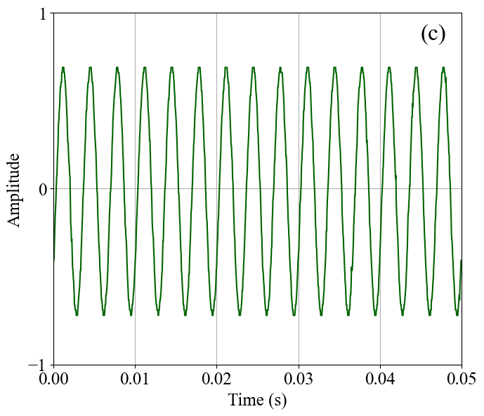
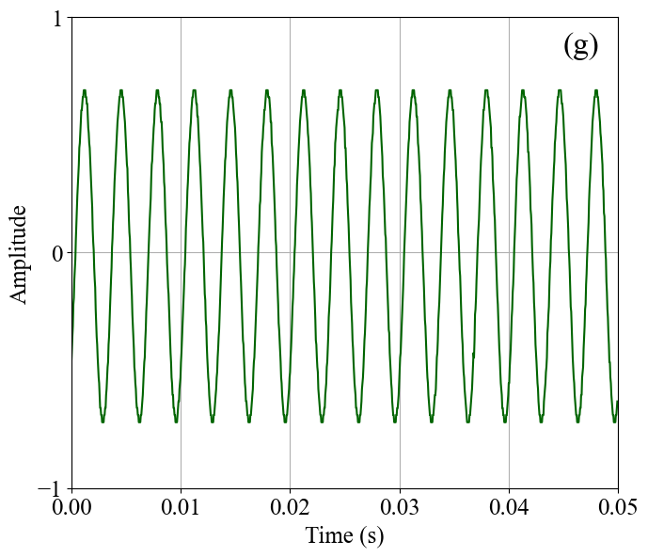
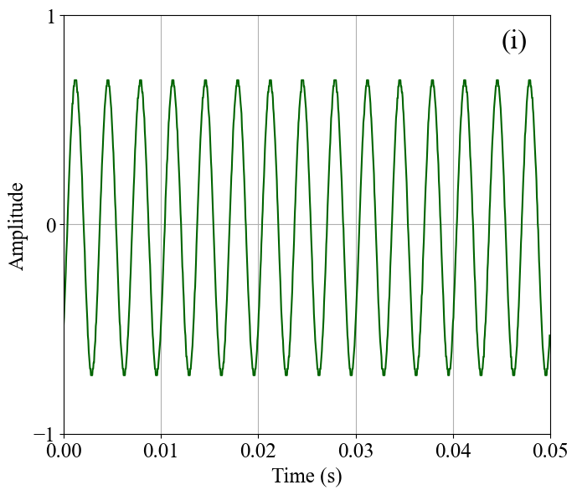
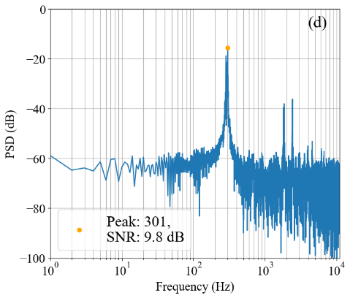
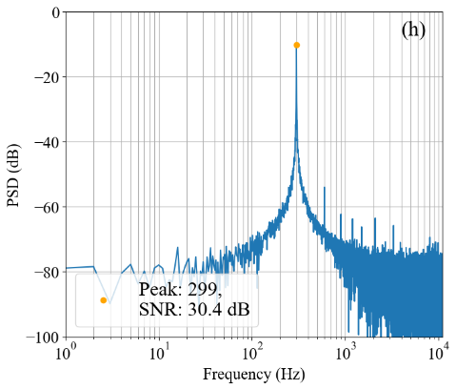
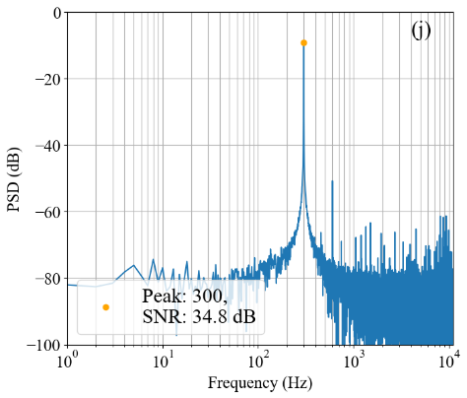
Inside Sinusoid Generation
300 Hz sinusoids
 | pQPNet | WNc | WNf
Waveform
Power spectral density (PSD)
Notes:
[inside test]
First, I show the results of inside tests. We can find that all models can generate clean sinusoids with accurate F0 and high SNR.

Slide 32
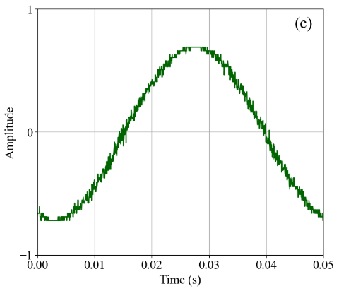
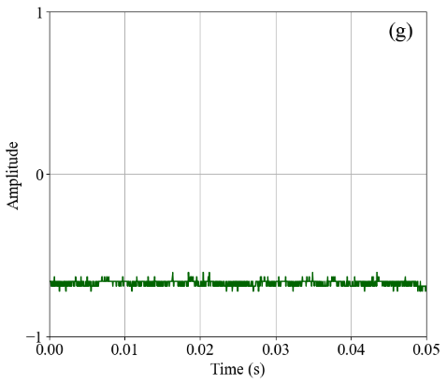
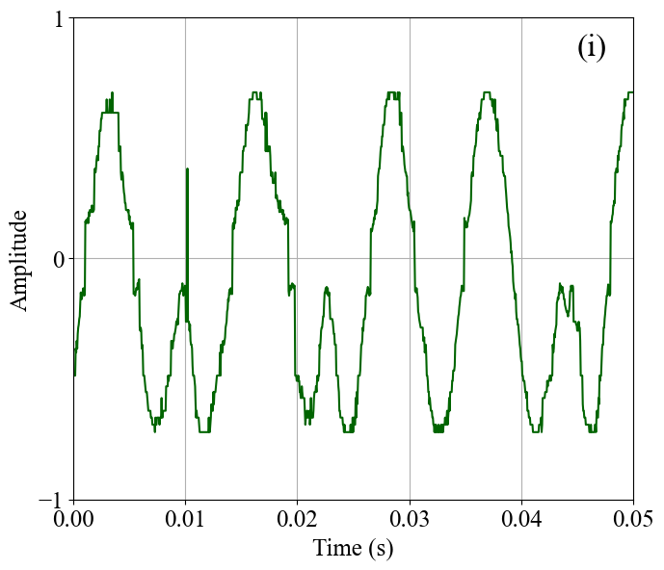
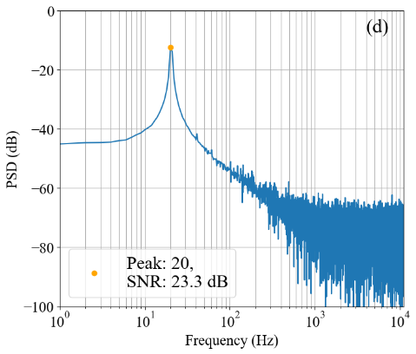
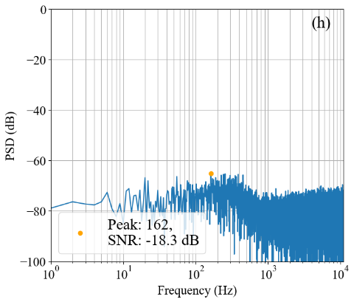
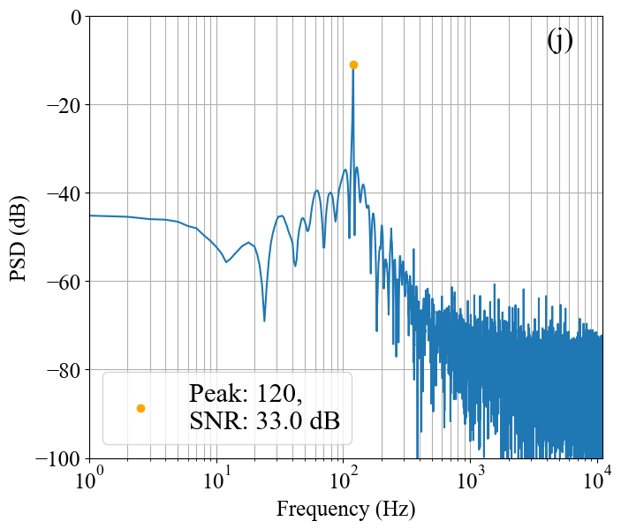
(Lower) Outside Sinusoid Generation
Accurate pitch
High SNR
Noise
Incorrect pitch
20 Hz sinusoids
 | pQPNet | WNc | WNf
Waveform
Power spectral density (PSD)
Notes:
[outside test]
Secondly, I show the results of the outside 20 Hz sinusoid generation. We can find that small WaveNet cannot generate a meaningful result, and the full-size WaveNet tends to generate a sinusoid with an inside F0 such as 120 Hz in this figure. However, the proposed pQPNet still generates a sinusoid with accurate F0 and high SNR.

Slide 33
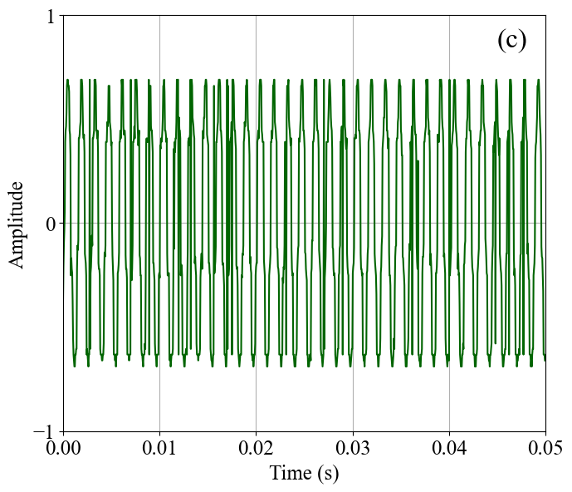
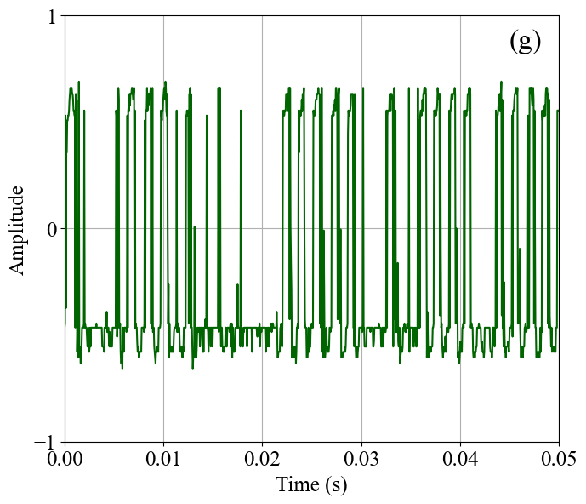
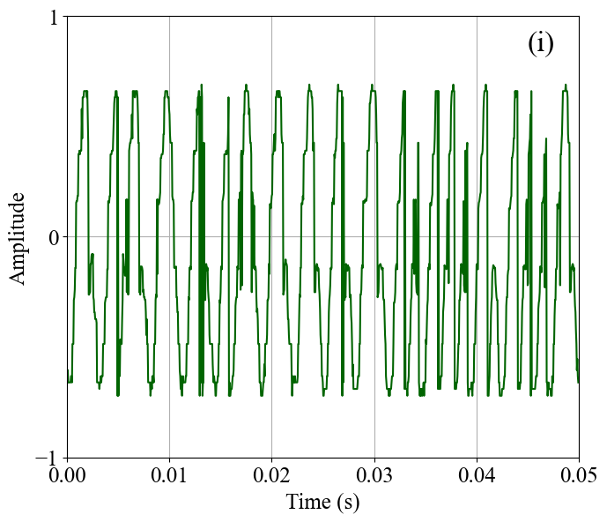
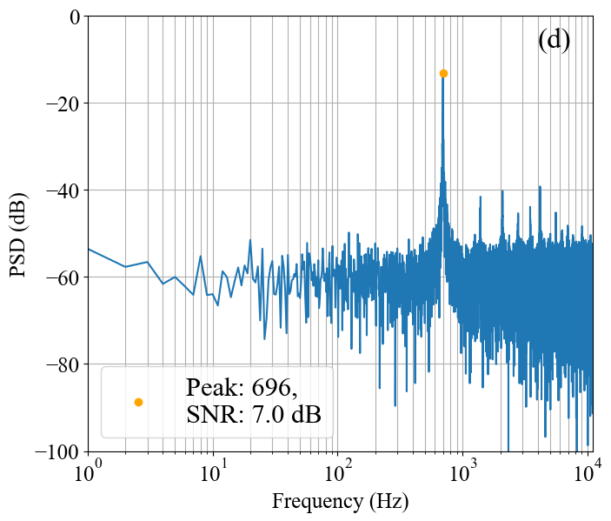
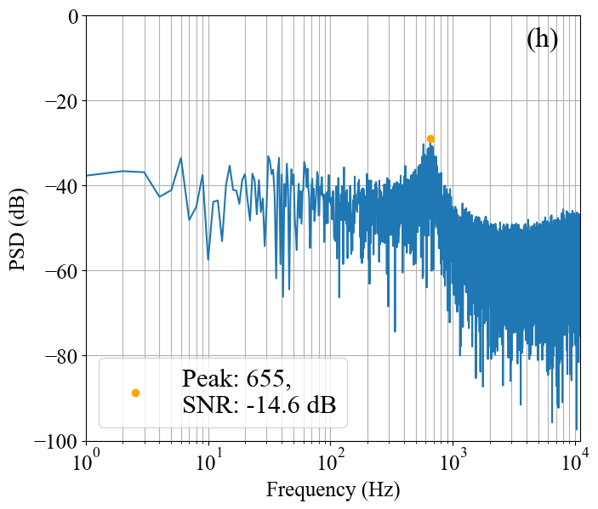
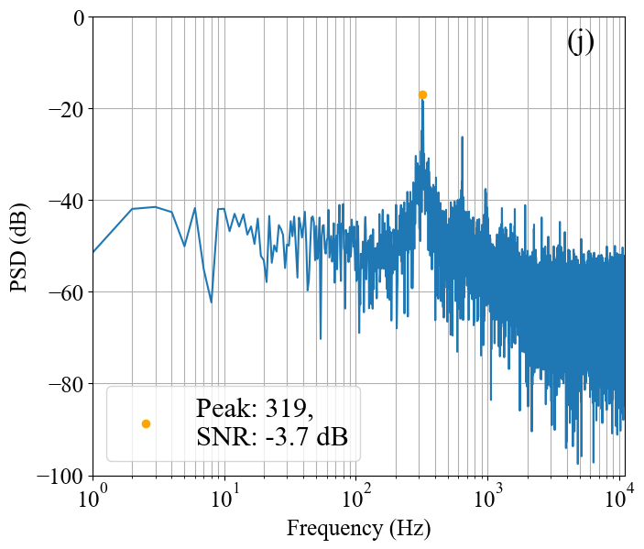
(Higher) Outside Sinusoid Generation
Accurate pitch
Higher SNR
Noisy
Incorrect pitch
700 Hz sinusoids
 | pQPNet | WNc | WNf
Waveform
Power spectral density (PSD)
Notes:
[outside test]
Furthermore, the 700 Hz results have a similar tendency. The small WaveNet generates a very noisy signal with a very low SNR, and the full-size WaveNet only generates a 300 Hz sinusoid, which has been seen in the training data. The proposed pQPNet still generates a clean sinusoid with more accurate F0 and higher SNR.

Slide 34
Speech Generation Experiments
Corpus
VCC2018 [J. Lorenzo-Trueba+, 2018]
Training: 12 speakers × 70 utterances (3s / utt)
Testing: 4 speakers × 35 utterances (3s / utt)
CMU ARCTIC [J. Kominek+, 2003]
Training 2 speakers × 1100 utterances (3s / utt)
Feature (WORLD-extracted)
1 dim F₀ and 1 dim U/V (unvoiced/voiced)
2 dim ap
35 dim mcep (mel-cepstrum)
Notes:
[speech generation experiments]
After checking the effectiveness of PDCNN, we also evaluated the QP structure for speech generation. The training corpus included VCC 2018 training data and partial CMU ARCTIC. The total data length is around 2.5 hours. The testing data included 4 speakers in the VCC2018 corpus, and each speaker had 35 utterances.
The acoustic features were extracted by WORLD vocoder, including 1 dim F0 and Voice/ unvoiced binary code, 2 dim ap, and 35 dim mel-cepstrum.

Slide 35
Subjective Evaluation I: QPNet and WaveNet
MOS (Mean Opinion Score) of speech quality
ABX (preference) of pitch accuracy
X: WORLD-generated reference
Notes:
[subjective 1]
First, we compared the proposed QPNet with WaveNet. We conducted a mean opinion score subjective evaluation of speech quality. The higher the score, the better the speech quality. According to the results, we can find that QPNet significantly outperforms the same sized WaveNet and achieve comparable speech quality with the double-sized original WaveNet. We also conducted a preference test of pitch accuracy to show the perceptually higher pitch accuracy of QPNet-generated speech.

Slide 36
Subjective Evaluation II: QPNet, QPPWG, and PWG
MOS of speech quality
Notes:
[subjective 2]
Secondly, we compared the proposed QPPWG and QPNet with PWG. According to the results, we can find that QPPWG also significantly outperforms the same sized PWG and achieves comparable speech quality with the larger sized original PWG in the normal F0 case. In scaled F0 cases, QPPWG even outperforms the original PWG.

Slide 37
Subjective Evaluation II: QPNet, QPPWG, and PWG
ABX of pitch accuracy
X: WORLD-generated reference
Notes:
The preference of pitch accuracy test also shows the perceptually higher pitch accuracy of QPPWG than PWG.

Slide 38
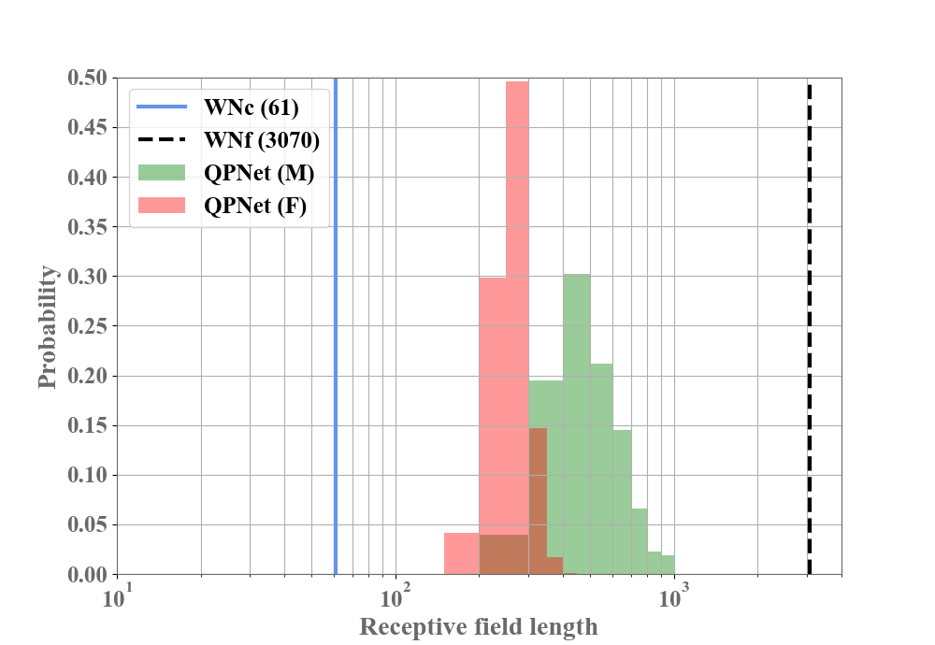
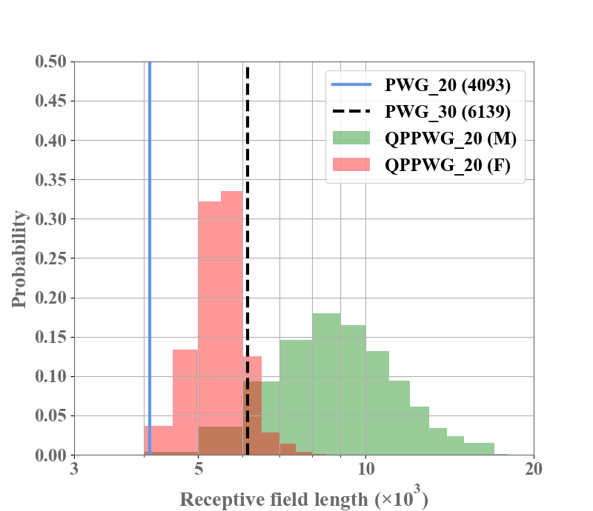
Receptive Field Extending
Efficiently increasing receptive field length
Skip some redundant information
Notes:
We also plot the receptive fields of QPNet and WaveNet, and QPPWG and PWG. We can find that the QP structure efficiently increases the receptive field length by skipping some redundant information.

Slide 39
Real-Time Factor
CPU (2.60 GHz, 32 threads)
Number of blocks ↓ ➔ Generative speed ↑
GPU
Feature map indexing degrades the CNN parallelization
Complexity ↑ ➔ Generative speed ↓
 | PWG_20 | PWG_30 | QPPWG_20
Intel Xeon Gold 6142 | 0.474 | 0.579 | 0.512
Nvidia TITAN V | 0.011 | 0.016 | 0.020
Notes:
[real time]
Since our goal is building a real-time system, we also evaluated generative speed in a real-time factor. First, we tested on a CPU with 2.6 GHz and 32 threads. According to the result, we can find that because of the reduced number of the residual blocks, the generative speed of QPPWG is faster than that of the original PWG. However, when tested on a GPU, because the feature map indexing degrades the CNN parallelization, the generative speed of QPPWG is slightly slower than the original PWG. However, since the generation is much faster than real time, the increased time is insignificant.

Slide 40
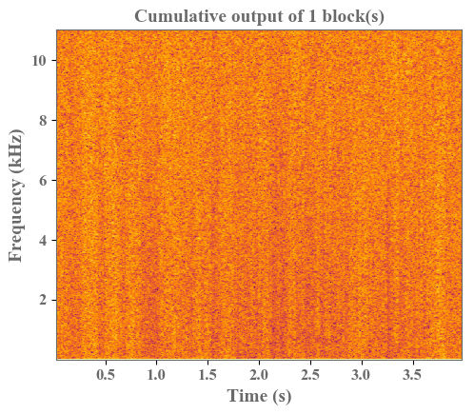
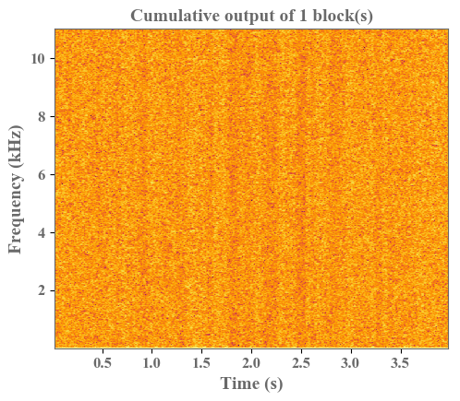
Understanding of QP Structure
Visualized intermediate outputs
Cumulative output of skip connections
PWG
QPPWG (adaptive → fixed)
Gradually generate both harmonic and non-harmonic components
First generate harmonic
and then
non-harmonic components
Notes:
[PWG v.s. QPPWG_af]
Since PWG and QPPWG directly output raw waveform samples, we can easily dissect the model to understand the internal generation mechanism. According to the visualized cumulative intermediate outputs, we can find that PWG gradually generates both harmonic and non-harmonic components. However, the QPPWG model with an adaptive-to-fixed order first generates the harmonic components and then the non-harmonic components. That is, the first 10 adaptive blocks focus on modeling pitch-related components and the last 10 fixed blocks focus on modeling spectral-related components.

Slide 41
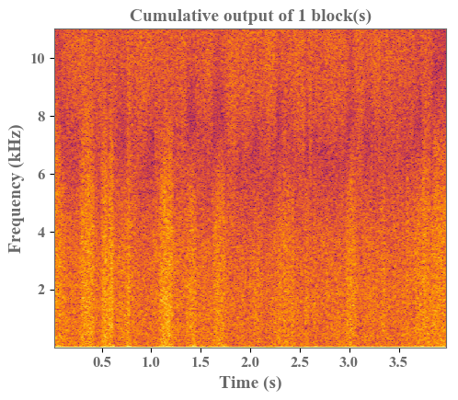
Understanding of QP Structure
Adaptive ➔ modeling source signal (harmonic component)
Fixed ➔ spectral filtering (non-harmonic component)
QPPWG (fixed → adaptive)
QPPWG (adaptive → fixed)
First generate non-harmonic
and then
harmonic components
Notes:
[QPPWG_fa v.s. QPPWF_af]
However, the QPPWG with a reversed fixed-to-adaptive order first focuses on non-harmonic components and then generate harmonic components.
The results confirm our assumption that the adaptive blocks modeling the pitch-related components with long-term dependencies, and the fixed blocks modeling the spectral-related components with short-term dependencies.

Slide 42
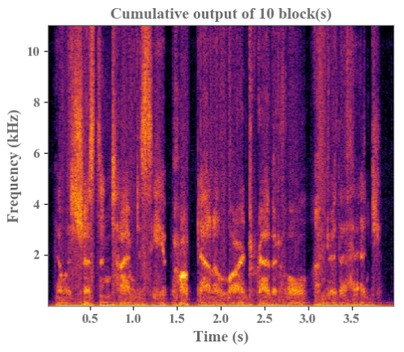

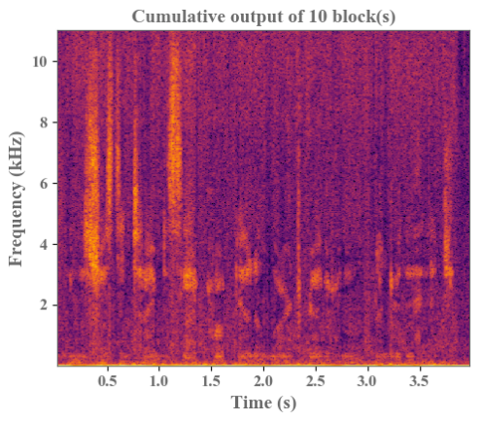
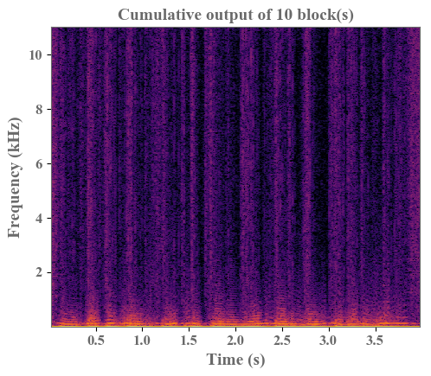
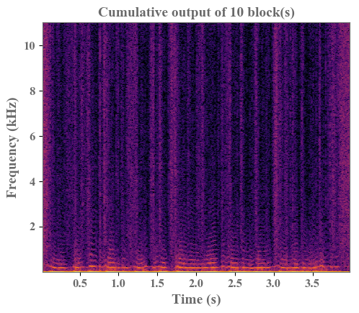
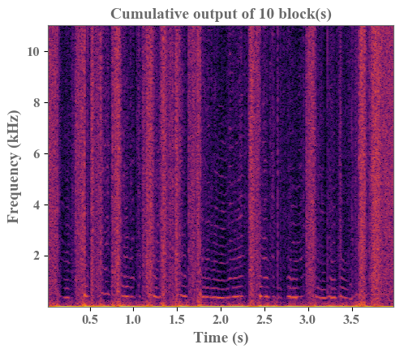
Source-filter Like Speech Modeling
½ pitch
1 pitch
2 pitch
First 10 fixed blocks of
QPPWG (fixed → adaptive)
Highly pitch-unrelated
First 10 adaptive blocks of
QPPWG (adaptive → fixed)
Pitch-related
Notes:
[source-filter like]
Furthermore, according to the intermediate outputs of the models conditioned on different pitch scaling, we can also find that the fixed blocks focus on modeling pitch-unrelated components, so the intermediate spectra of the fixed blocks are very similar even if the conditional F0 scalings are different. On the other hand, the adaptive blocks focus on pitch-related components, so the intermediate spectra are changed corresponding to the F0 scalings.

Slide 43
QPPWG and NSF
QPPWG:
Adaptive and fixed macroblocks are analogous to the excitation generation and spectral filtering modules
NSF [X. Wang+, 2019]
Explicitly model excitation signal and spectral filtering
Notes:
[QPPWG and NSF]
Although QPPWG is a unified vocoder, its behavior and structure are very similar to the source-filter model. The adaptive blocks are analogous to the excitation generation and the fixed blocks are analogous to the spectral filtering.
Compared with the neural source-filter model, which also adopts a non-AR DCNN architecture, the main difference is that the excitation generation of QPPWG is performed by a neural network.

Slide 44
Deformable CNN [J. Dai+, 2017]
CNN: fixed sampling grid
DCNN: fixed sampling grid w/ fixed offsets
Deformable CNN: deformable sampling grid w/ input-dependent offsets
Notes:
[Deformable CNN]
The idea of a dynamically updated attention mechanism making a network know “where to look” at each time step is not new. Deformable CNN is an example, which achieves markedly improvement in the object detection task. Specifically, for CNN, the sampling grid is fixed, so the coverage of a single kernel is also limited. The straightforward way to enlarge the coverage while keeping the computation cost the same is by increasing the dilation size like DCNN. However, the fixed offsets of the sampling grid are inefficient, the enlarged coverage may also contain many undesired areas. Therefore, the authors of deformable CNN proposed learnable time-variant sampling offsets to make the network focus on the desired areas.

Slide 45
PDCNN and Deformable CNN
Input of CNN is indexed feature map
Deformable CNN ➔ Index is predicted by a NN
PDCNN ➔ Index is calculated from F₀ and F_{s}
Notes:
[PDCNN and Deformable]
The idea is very similar to our proposed PDCNN for changing the index of the input feature map. The main difference is that deformable CNN adopts a neural network to predict the index, but the index of PDCNN is parametrically determined by the input pitch and sampling rate. Therefore, PDCNN is a special case of deformable CNN with prior knowledge of pitch.

Slide 46
Conclusion
RNN-based
Pro: Recurrent structure theoretically enables the network to model arbitrary length of correlations
Con: Limited model complexity for real-time generation
Focus: Only modeling minimum essential information
CNN-based
Pro: Parallelized computation for real-time generation
Con: Fixed geometric structure limits memory capacity
Focus: Non-AR modeling algorithm; Adaptive network w/ a free from of sampling grid
Notes:
[vocoder]
To summarize recent speech generative methods, for the RNN-based models, the pro is the recurrent structure theoretically enables the network to model arbitrary length of correlations. However, the con is the model complexity should be very limited due to the real-time generation requirement. As a result, current researches of RNN-based speech generation focus on only modeling minimum essential information with a very limited model size such as LPCNet.
On the other hand, for the CNN-based models, the pro is that we can take advantage of the parallelized computation nature of non-AR CNN for the real-time generation even if the model is very complicated. However, the con is the fixed geometric structure limits the memory capacity of the models. As a result, current researches of CNN-based speech generation first focus on non-AR modeling algorithms such as flow-based and GAN-based models and then focus on adaptive networks with a free form of sampling grid such as our QPNet and QPPWG.

Slide 47
Conclusion
PDCNN
Simple and general for any CNN-based model
QP structure
Pitch-dependent adaptive network
Analogous to a source-filter model
Tractable and interpretable
QPNet/QPPWG compared with WN/PWG
Smaller model size
Better pitch controllability
Comparable speech quality
Notes:
[QP]
For our proposed modules and models, PDCNN is very simple and can be easily integrated into any CNN-based model. The QP structure makes a pitch-dependent adaptive network available, and its source-filter like architecture is more tractable and interpretable.
Compare with original WaveNet and PWG, the proposed QPNet and QPPWG respectively achieve better pitch controllability and similar speech quality with smaller models.

Slide 48


Thank you for your attention ! https://bigpon.github.io/QuasiPeriodicWaveNet_demo/ https://bigpon.github.io/QuasiPeriodicParallelWaveGAN_demo/
Notes:
[Demo]
If you are interested in my research, please visit my demo pages.Thanks for your attention.

